Slide 1

Case Study 2: TITANIC Study
Vincent Mostert

Slide 2


Introduction
This study will use a dataset on the Titanic disaster. We will look at different features of the data to predict whether a person survived the tragedy or not. For this we will use:
Logistic Regression
Decision Tree Classifier
Naïve Bayes Classifier
Experimental Addition:
KBest + LASSO (Feature Selection + Hyperparameter Testing)

Slide 3

Dataset

Slide 4
Information on the Data
Size: The data has 891 entries (rows).
Columns: There are 15 columns in total, with each column having a specific name.
Data Types: The data types of the columns include float64, int64, object (containing strings), and categories for the features.
Non-Null Count: Several columns had null values: age (19.82%), embarked (0.22%), deck (77.22%), embark_town (0.22%).
Duplicate rows: The dataset contained 107 duplicate rows which were deleted in the EDA phase.

Slide 5
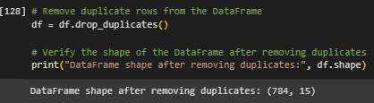
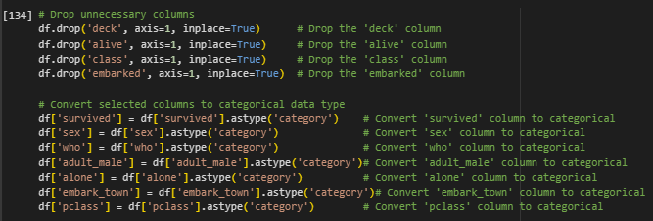
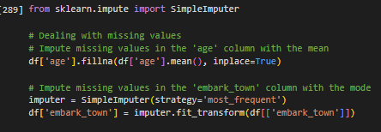
Treating the data.
It is recommended to remove duplicates, handle missing values and adjust the types of the features before starting any analysis on a dataset.*
Dropping duplicates.
Converting and dropping features.
Treating missing values.
* Lianne & Justin @ Just into Data. (2022, October 31). Data Cleaning in python: The ultimate guide (2020). Medium. https://towardsdatascience.com/data-cleaning-in-python-the-ultimate-guide-2020-c63b88bf0a0d

Slide 6
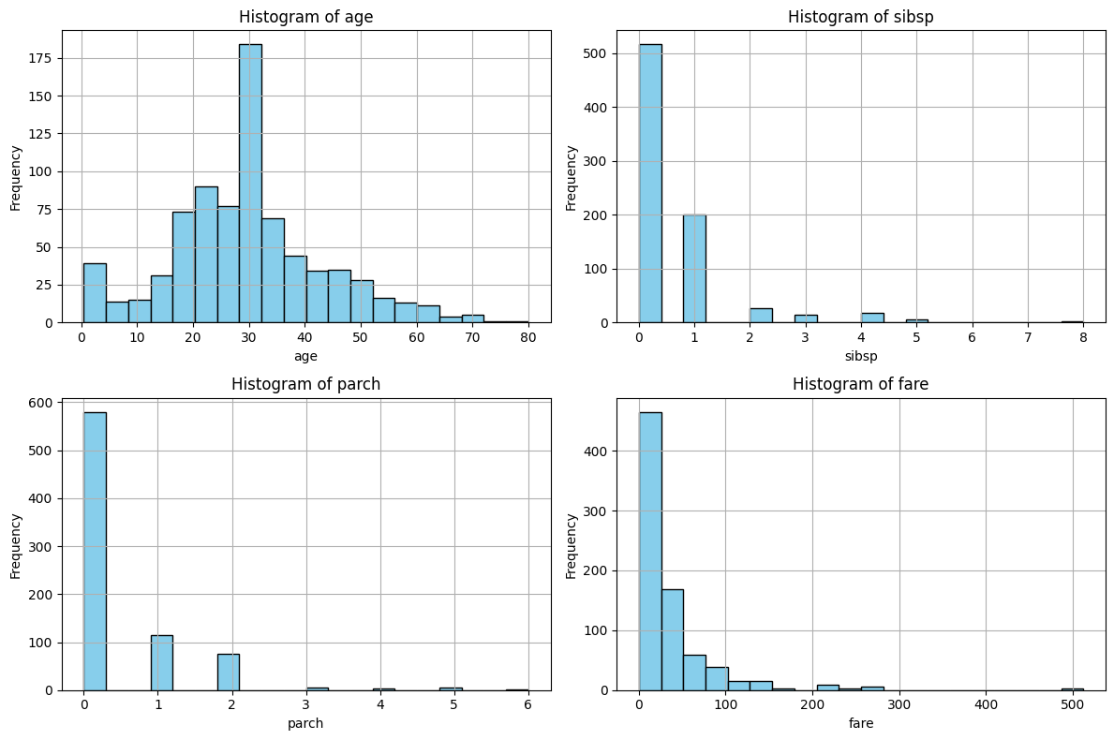
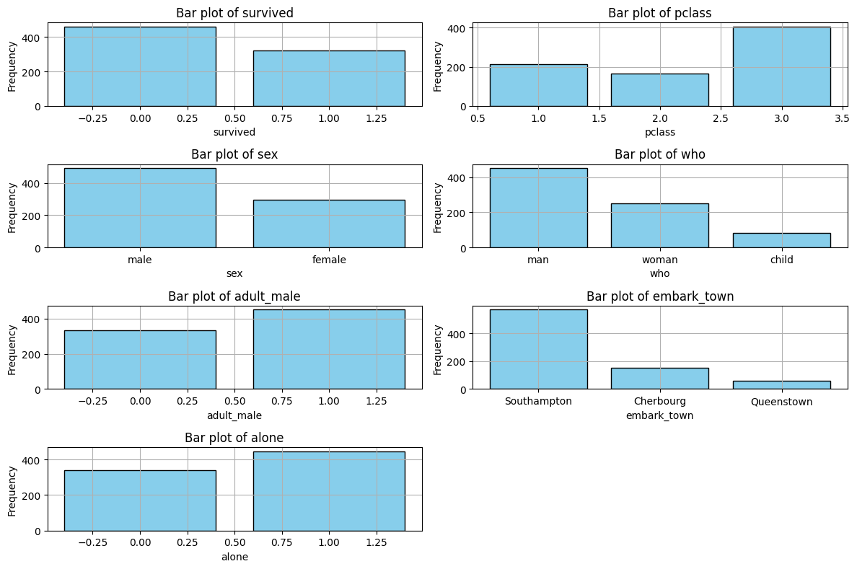
EDA (univariate)
More casualties than survivors.
A lot of right skewed numerical data.

Slide 7
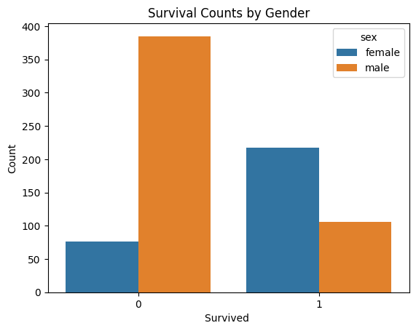
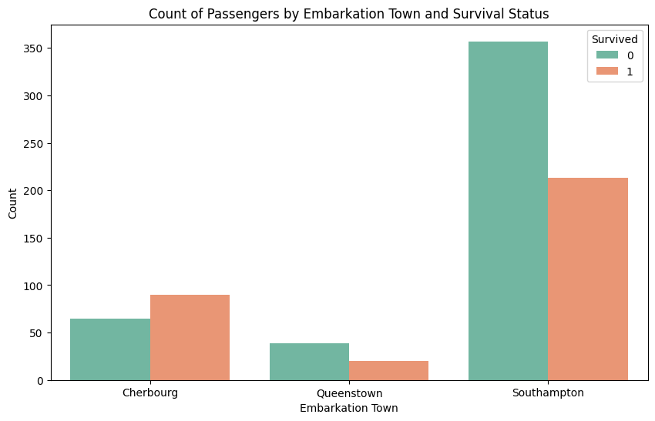
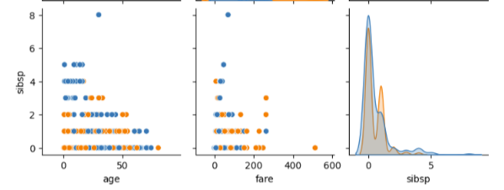

EDA (Bivariate & Multivariate)
More male survivors than female casualties.
Most deaths and embarked passengers came from Southampton
Very low correlations between the numerical data.

Slide 8
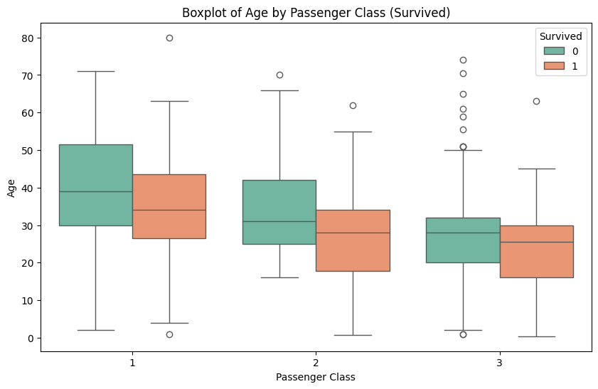
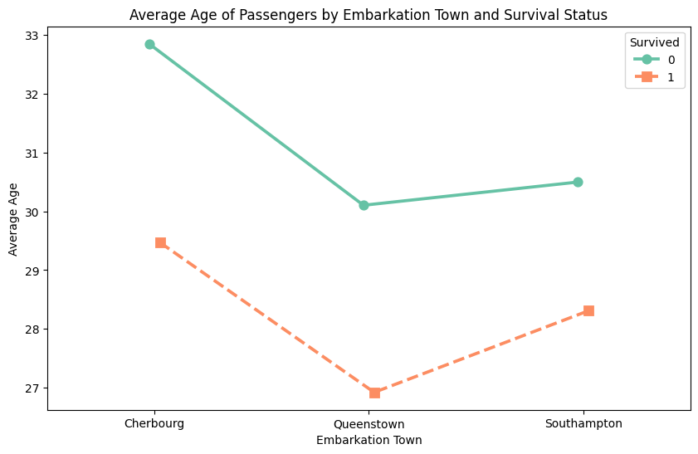
EDA (Multivariate)
Age of survivors is lower on average than the casualties, and the lowest in Queenstown.
People from 1st class were older on average than the people from 2nd and 3rd. Again, we can see that the average age of the survivors is lower than the casualties.

Slide 9

TIMELINE AFTER EDA

Slide 10
Timeline Regressions
Outlier Removal
Removing the outliers (no more than 5%).
Regressions
The models used: Logistic Regression, Decision Tree Classifier, GaussianNB
Evaluation
Evaluating the different metrics: f1 score, accuracy, precision, recall, specificity, ROC curve.
KBest + LASSO
Summary
Implementing feature selection techniques combined with hyperparameter testing to see if we can achieve better results..
Summarizing the findings from all regressions and their results.

Slide 11
Business Case Objective
2 main objectives for this study:
Develop a predictive model that can effectively identify the survivors and minimize incorrectly flagging deceased passengers as survived.
For this case study, we will choose the model with the highest accuracy.

Slide 12
Regressions
Steps:
1. Keeping only the numerical features for the regressions:
X = df.drop(['survived', 'sex', 'pclass', 'who', 'adult_male', 'embark_town', 'alone'], axis=1)
y = df['survived’]
2. Initializing the 3 different models:
Logistic Regression
Decision Tree Classifier
Gaussian NB
3. Fitting the model with the train data
4. Generating predictions with the test data
5. Scoring the models (see next slide)

Slide 13
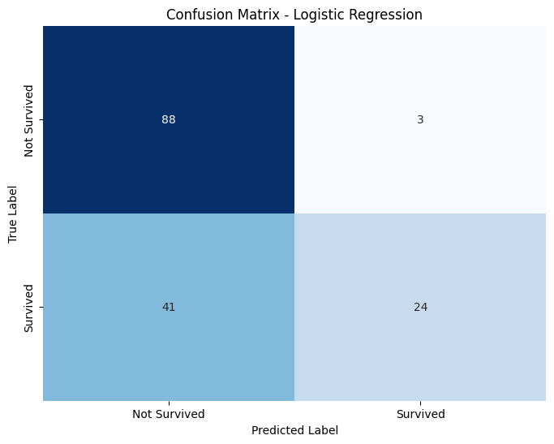
Logistic Regression
Results
Accuracy: 0.718
Precision: 0.889
Recall: 0.369
Specificity: 0.967
F1 Score: 0.522
→ Decent model, good precision and accuracy. Great specificity.

Slide 14
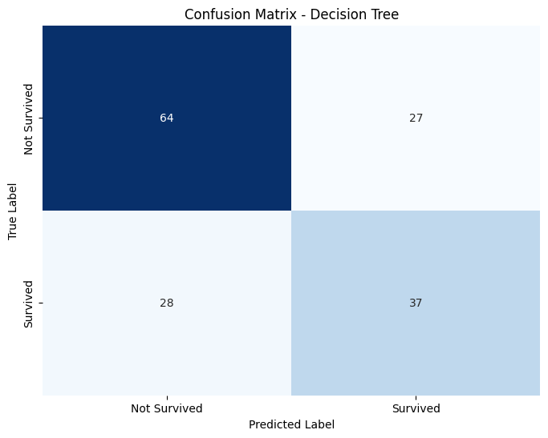
Decision Tree Classifier
Results
Accuracy: 0.641
Precision: 0.571
Recall: 0.554
Specificity: 0.703
F1 Score: 0.562
→ Bad model, worse accuracy, precision, and specificity. Better on recall and F1.

Slide 15
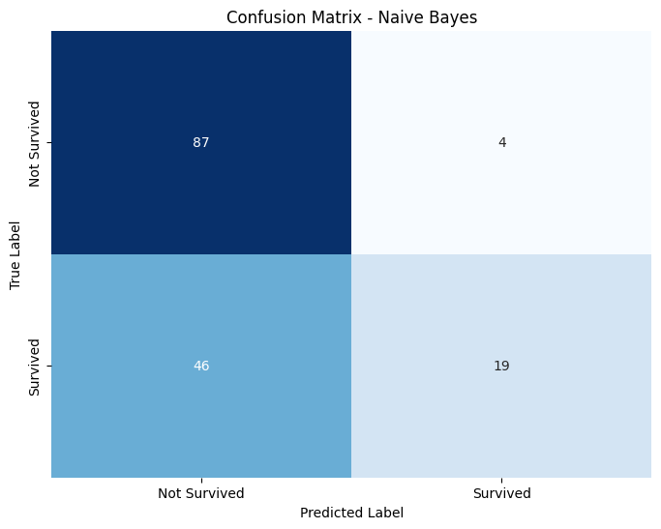
Gaussian NB
Results
Accuracy: 0.679
Precision: 0.826
Recall: 0.292
Specificity: 0.956
F1 Score: 0.432
→ Similar to the Logistic Regression but on all metrics worse.

Slide 16
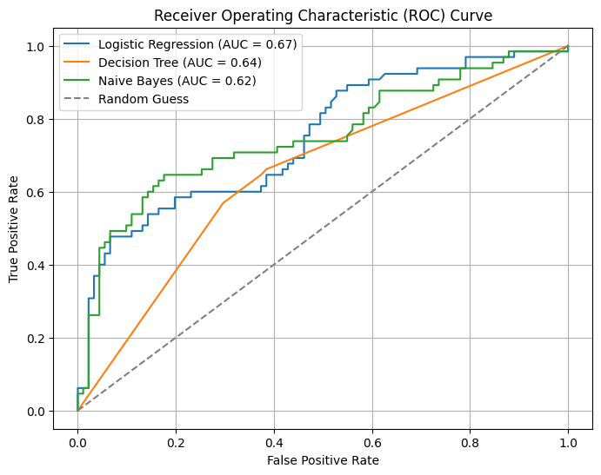
ROC Curve
Based on ROC AUC Scores:
Logistic Regression: 0.6681
Decision Tree: 0.6341
Naive Bayes: 0.6242
Analysis:
Logistic Regression outperformed Decision Tree and Naive Bayes with the highest ROC AUC score.
This score indicates its superior ability to differentiate between survivors and non-survivors, crucial for Titanic survival prediction.
Recommendation:
Adopting Logistic Regression is recommended for predicting survival outcomes on the Titanic dataset, given its highest ROC AUC score among the models provided.

Slide 17
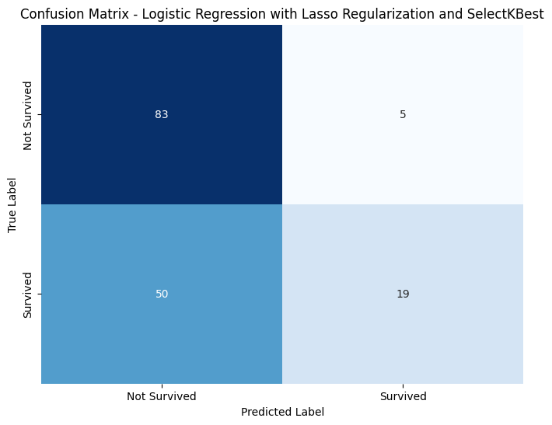
KBest + LASSO (Feature Selection + Hyperparameter testing)
Results
Accuracy: 0.712
Precision: 0.857
Recall: 0.369
Specificity: 0.956
F1 Score: 0.516
→ Slightly worse than Logistic Regression but only uses 3 features and uses regularization (better for computing and overfitting).

Slide 18
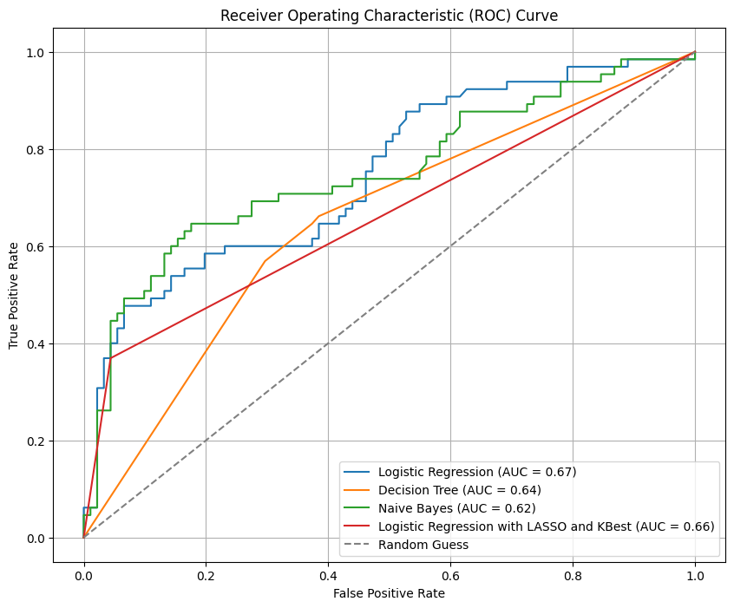
ROC Curve (KBest + LASSO)
ROC AUC Scores Comparison
Logistic Regression: 0.668
Decision Tree: 0.634
Naive Bayes: 0.624
Logistic Regression with LASSO and KBest: 0.662
Model Assessment
Logistic Regression achieved the highest ROC AUC score (0.668), followed closely by Logistic Regression with LASSO and KBest.
Business Case Consideration
Accurately identifying survivors is crucial for the Titanic scenario.
Higher ROC AUC scores imply better discrimination ability, vital for informed decision-making.
Interesting Remark
Despite slightly lower ROC AUC, Logistic Regression with LASSO and KBest offers improved interpretability and reduced complexity, presenting a trade-off between performance and simplicity.

Slide 19



Summary
Logistic Regression:
Provides a solid baseline for survival prediction.
Lacks feature selection, potentially leading to overfitting and increased computational costs.
Logistic Regression with LASSO Regularization and KBest:
Utilizes feature selection techniques, reducing complexity and risk of overfitting.
Enhances computational efficiency by using one less feature.
Recommendation:
Logistic regression with LASSO regularization and KBest balances accuracy and efficiency.
It accurately identifies survivors while minimizing false alarms.
Recommended for predicting survival on the Titanic due to its balanced performance and efficiency.

Slide 20


THANK YOU
Vincent Mostert

